Slide 1
Ontologies using OWL and SHACL
Capgemini Academy
Company confidential

Slide 2
House Rules
Breaks every 60 minutes (or so)
Lunch at …
Ask questions at any time
Minimize non-training information input...

Slide 3
Agenda
01
Introductions
02
Linked Data/RDF recap
03
On capturing a domain
04
Deep dive: OWL
05
Deep dive: SHACL
06
OWL vs SHACL
07
Closing

Slide 4
Introductions

Slide 5

About Me
Amir Westhoff
Joined Capgemini in 2018
Managing Consultant / Information Architect
Worked with Linked Data/RDF since 2018 at:
  Logius
  Dutch Police
  Ministry of General Affairs
  UWV
  Altria (US)
Wrote three articles on Linked Data/RDF for Capgemini publications
Developed three Capgemini Academy trainings

Slide 6

What about you?
What is your name?
What type of roles have you had in recent times?
Does your current job/assigment involve Linked Data/RDF/ontologies/knowledge graphs?
Is there anything particular you would like to learn in this training?

Slide 7
Capgemini Academy trainings on Linked Data
Ontologies using OWL
and SHACL
Introduction to Linked Data
Taxonomies and Thesauri
in SKOS
Foundation
Practitioner
Expert

Slide 8
Linked Data/RDF
recap

Slide 9
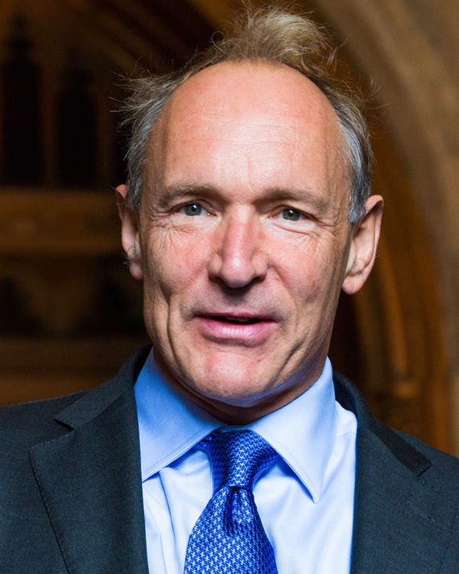
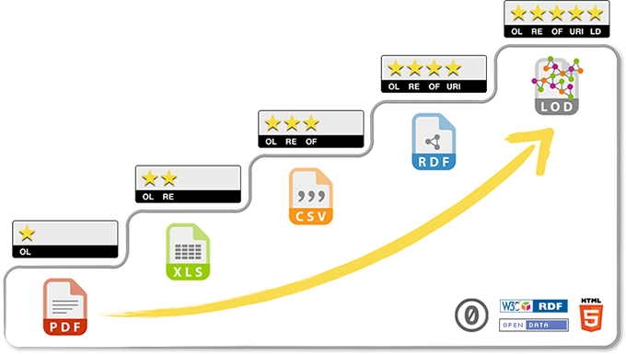
Linked Data 101
Linked Data is data that follows the open W3C-standard Resource Description Framework (RDF) and relevant best practices
RDF was invented by Tim Berners-Lee at W3C
Also called Linked Open Data, but principles can also be applied to closed data
Basically, a different way of dealing with data, using open (web) standards
Related concepts: Knowledge Graphs, FAIR data

Slide 10
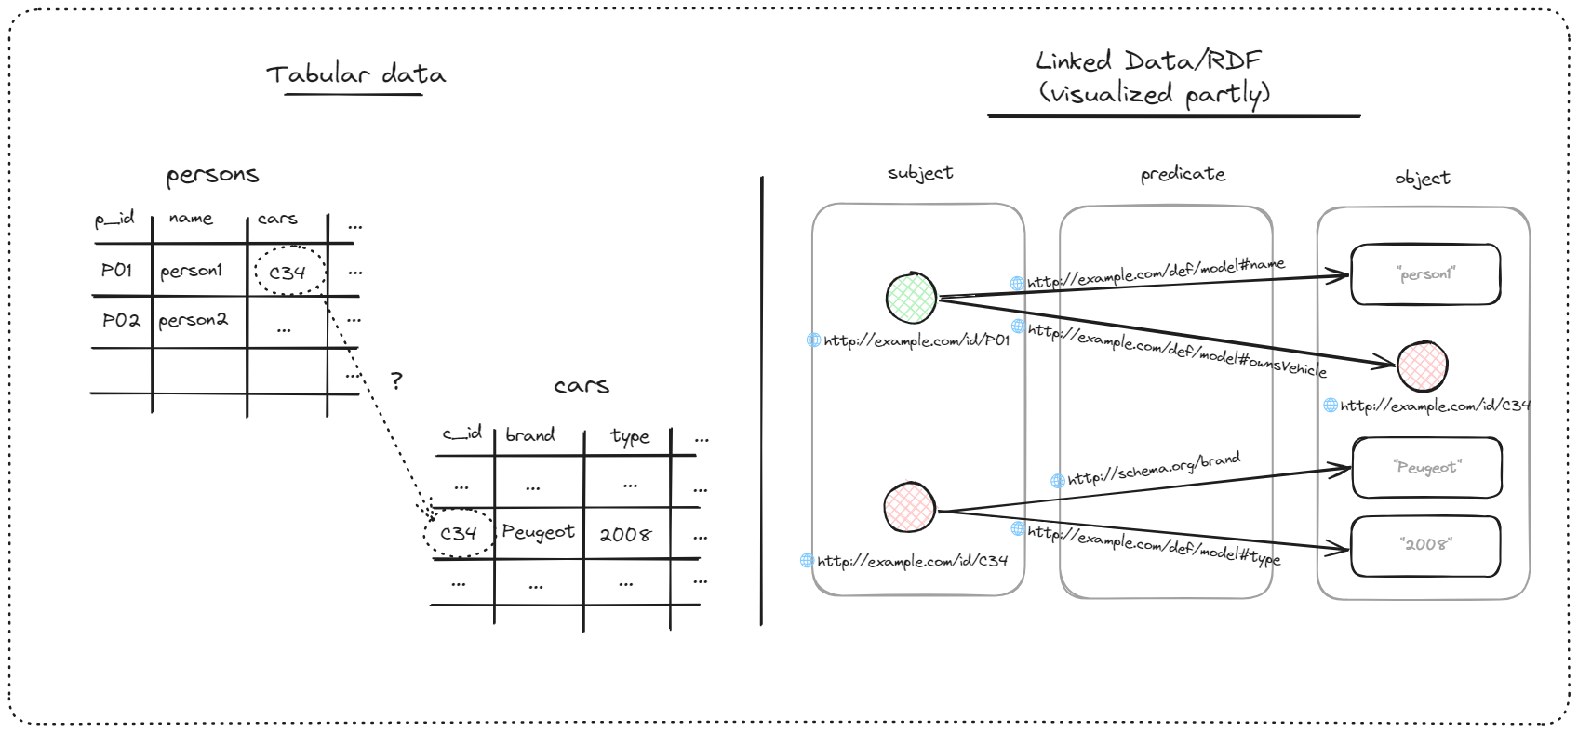
Linked Data 101
Tabular data vs Linked Data/RDF
Implicit semantics
HTTP-URIs as
identifiers
(Explicit) Semantics
can be reused
Relationships
also have
identity
Data in a graph paradigm

Slide 11
Five take-aways
Data interoperability
Relationships are first class citizens
Data in graph paradigm
Model is part of the data
Reuse of URIs and semantics
RDF triples allow easy merging
of data
Relationships can be annotated,
have subproperties, etc.
Model elements are thus available
for analysis, querying, and
advanced capabilities
Operations that draw from
graph theory are performed easier
than with tables
By reusing HTTP-URIs from other parties,
semantics are also reused

Slide 12
RDF Vocabularies
An RDF vocabulary is a collection of concepts and relationships, published as RDF, that have been previously defined (by working groups) for a specific use case
Several ubiquitous vocabularies:
RDF vocabulary | Full name | Use case
RDF | Resource Description Framework | Basic building blocks for having data as RDF
RDFS | RDF Schema | Simple schema
OWL | Web Ontology Language | Ontologies based on first order logic/set theory and in an open world assumption
SHACL | Shapes Constraint Language | Data validation / ontologies in a closed world assumption
SKOS | Simple Knowledge Organization Systems | Taxonomies, thesauri, simple concepts and concept schemes

Slide 13
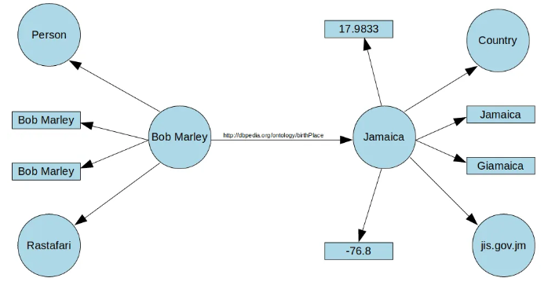
Reading Linked Data/RDF
RDF has various serialization forms: N3-Triples, XML, JSON-LD, Turtle
Below graph will be used as example

Slide 14
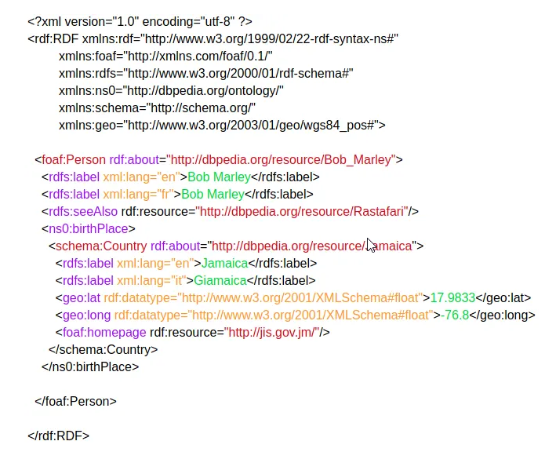
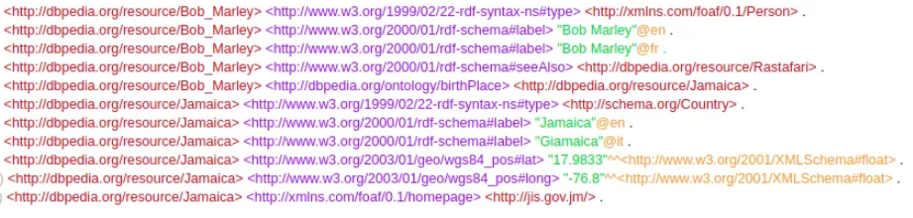
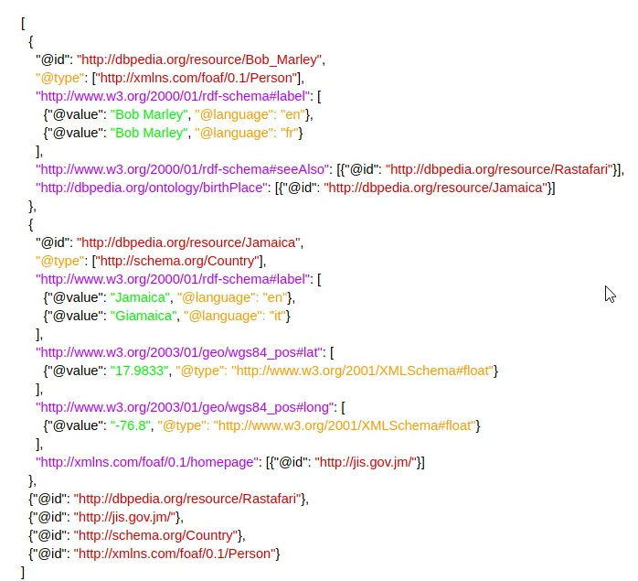
Reading Linked Data/RDF
N3-Triples, JSON-LD, RDF/XML: All RDF, but...
N3-Triples
RDF/XML
JSON-LD

Slide 15
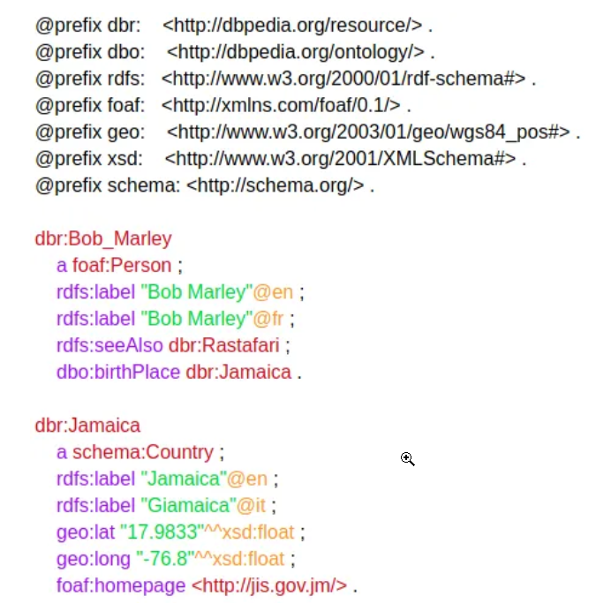
Reading Linked Data/RDF
..., the Turtle syntax offer the best readability for humans
Turtle
Prefixes for shortening URIs
No need to repeat the subject
when using the semicolon (“;”). Close off
the list of predicate-object
combinations with a period (“.”) .
Only the space between
subject – predicate – object
is important

Slide 16
Reading Linked Data/RDF
Some conventions
Turtle
relationships/attributes
in camelCase
Classes begin with capitalized letter

Slide 17
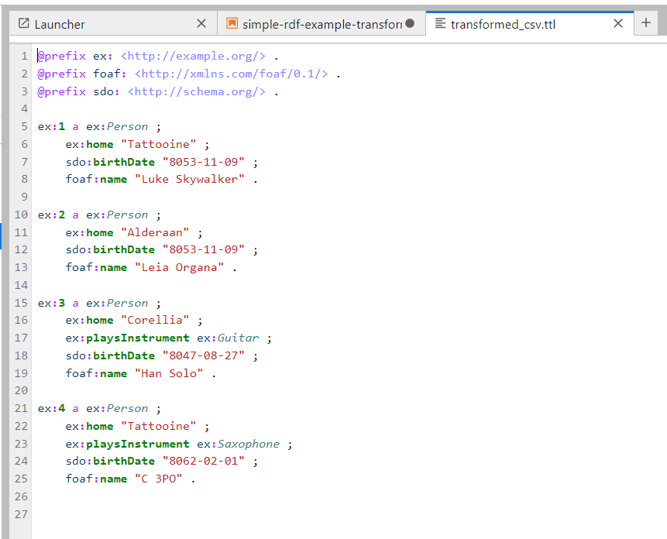
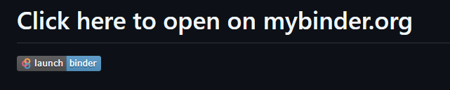
Notebook: simple-rdf-example-transformations.ipynb
Let’s open the `simple-rdf-example-transformations.ipynb` notebook
https://github.com/amirwesthoff/ontologies-using-owl-and-shacl/tree/main

Slide 18
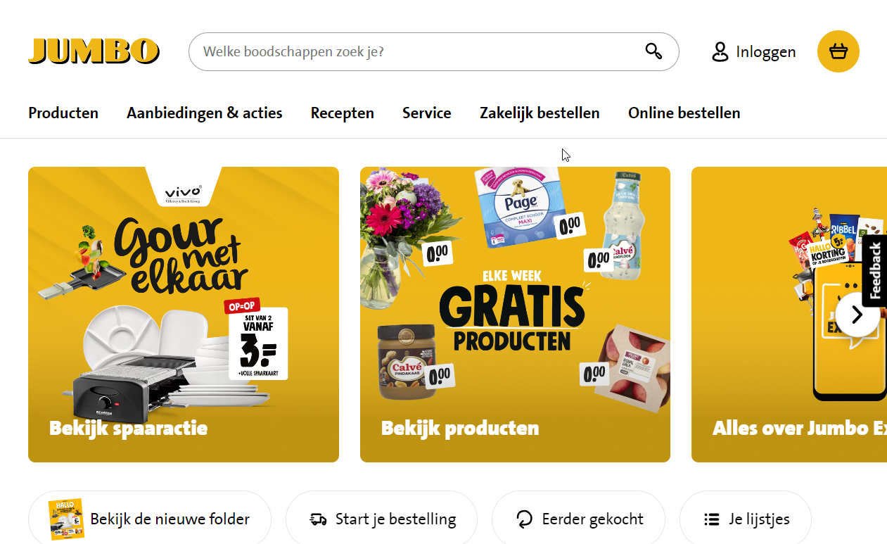
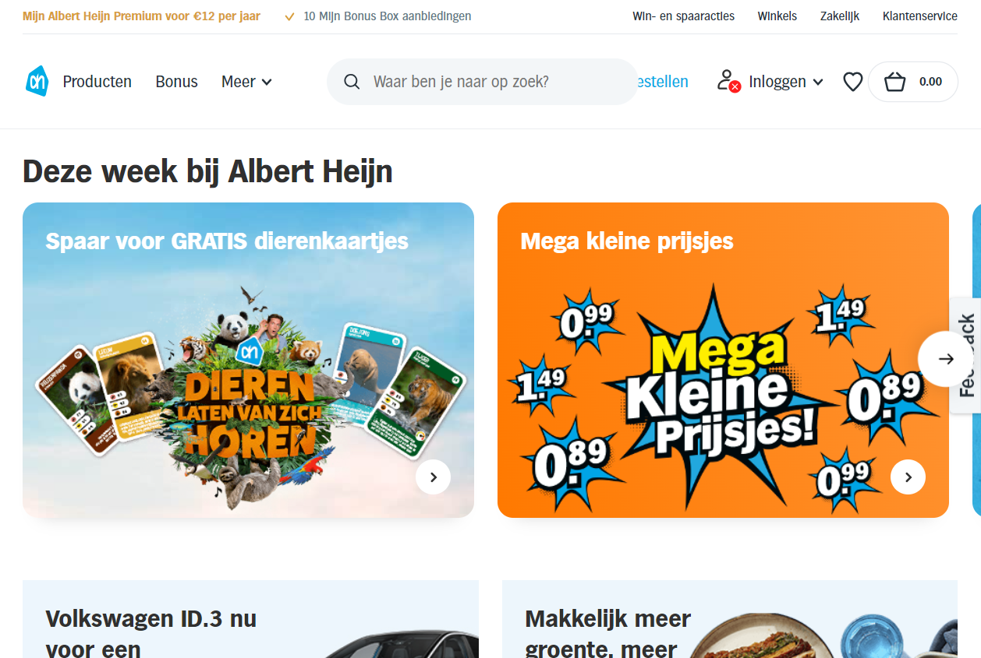
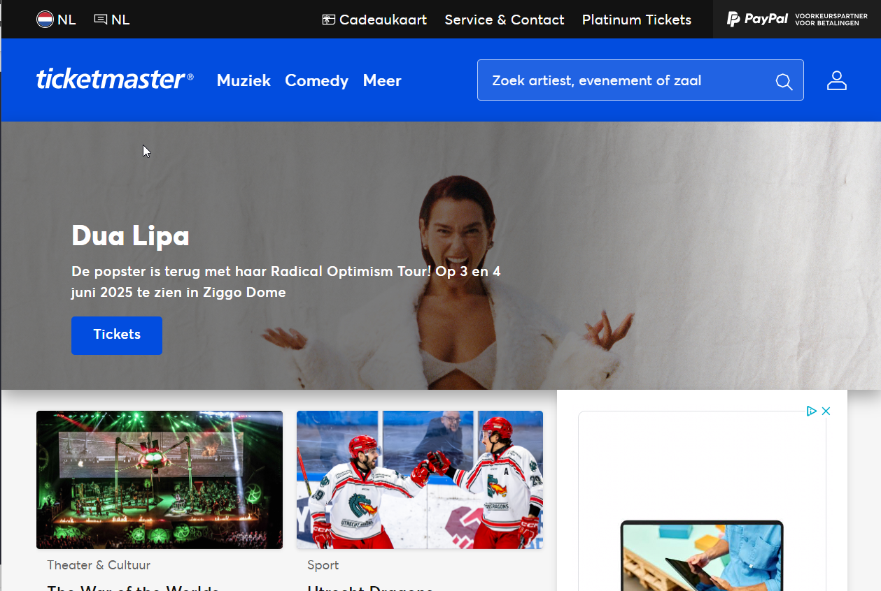
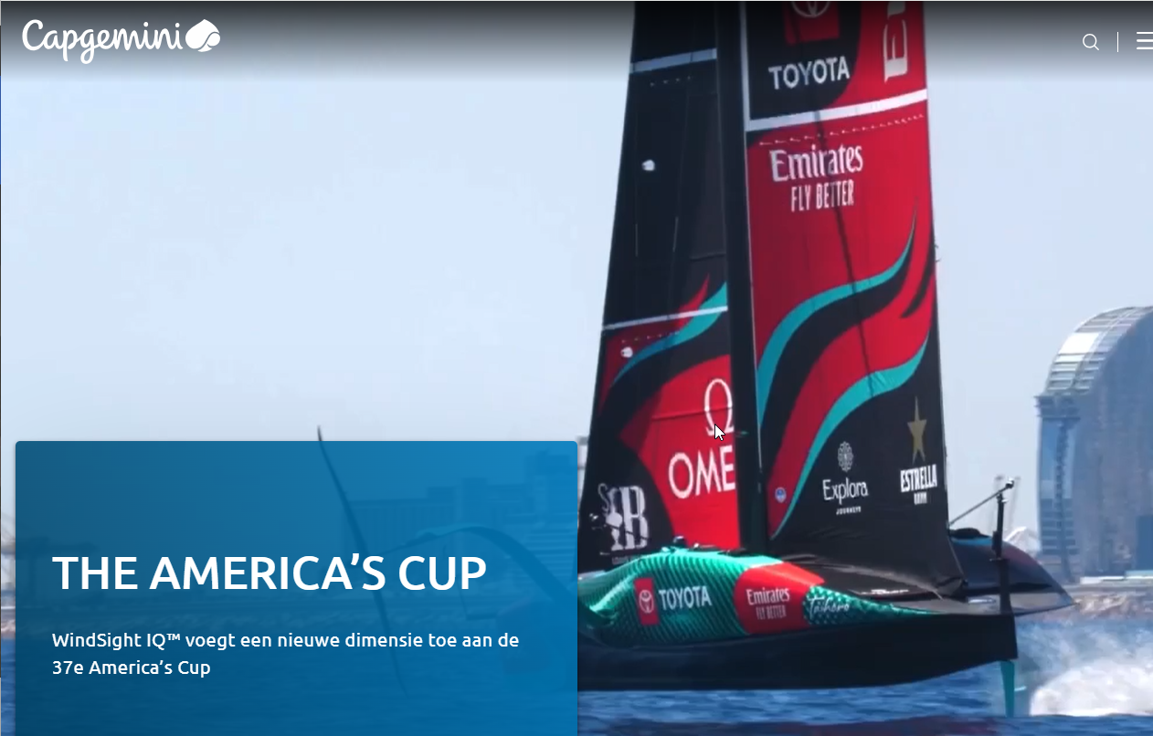
Discussion
What are your thoughts on RDF so far?
Exotic?
Any thoughts on why adoption has (presumably) been slow? Or has it?
What about your experiences,
if any?

Slide 19
References / Recommend reading
https://5stardata.info/en/
https://www.w3.org/wiki/LinkedData
https://www.w3.org/TR/turtle/

Slide 20
On capturing a domain

Slide 21
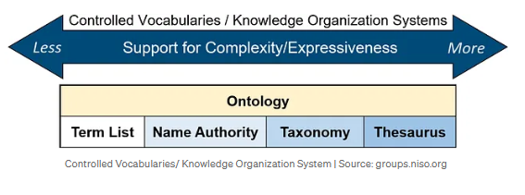
Discussion: what came to mind first?
Data modeling?
  Entities/Attributes/Relationships?
  Conceptual/Logical/Physical?
In the context of Semantic Web Technologies, there are three vocabularies that are typically used
  SKOS → Glossary/Taxonomy/Thesaurus: Simple Terms and definitions
  OWL → Ontology: formal model of how things are related to enable reasoning
  SHACL → Shapes: to perform data validation

Slide 22
Deep Dive: OWL

Slide 23
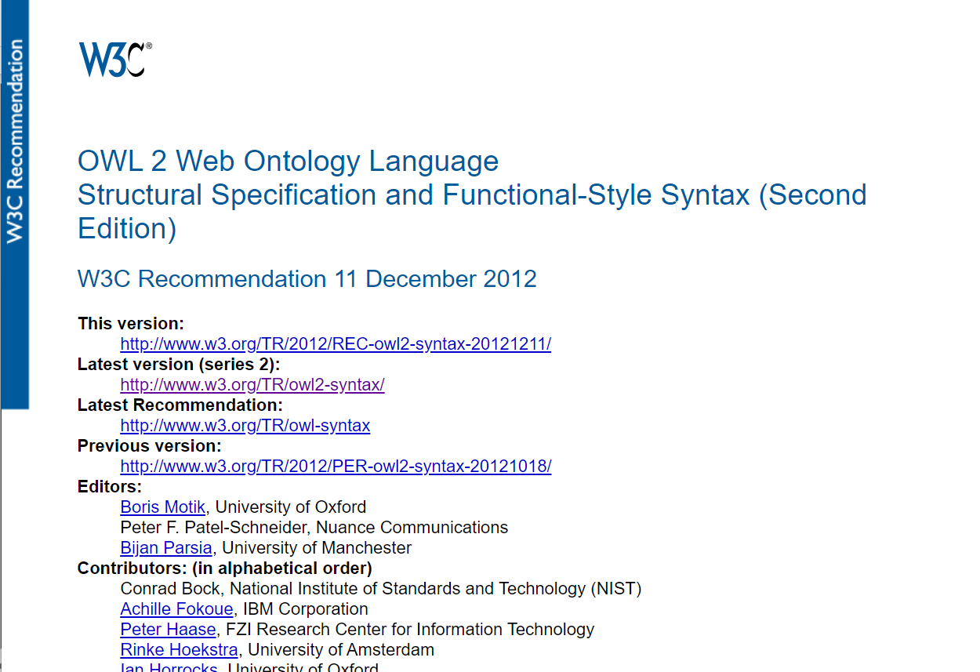
OWL
Web Ontology Language
2012
Built on top of RDFS (RDF Schema)
Designed to enable reasoning based on description logic and set theory
Open World Assumption

Slide 24
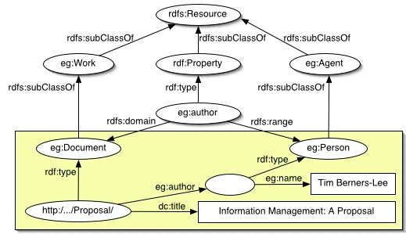
OWL
Let’s look at RDFS first
Sufficient for simple schemas/hierarchies
Not possible to characterize relationships (symmetrical, transitive, etc.)
Not possible to specify class disjointness
As we will see: more expressivity with OWL

Slide 25
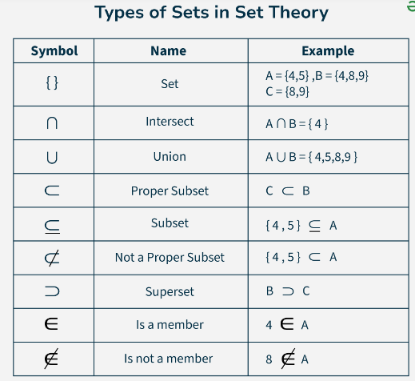
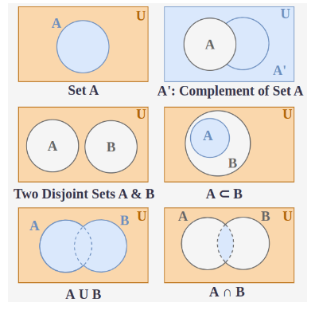
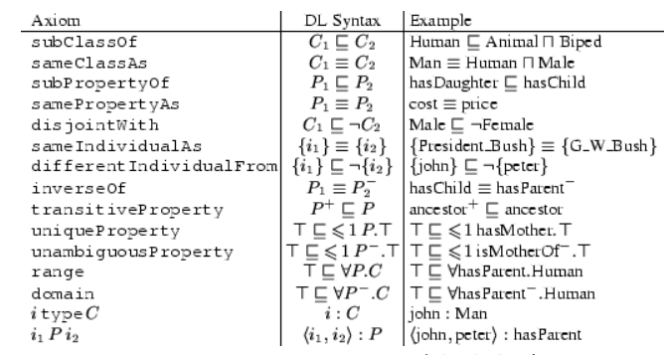
OWL
Set theory and description logics
Set theory: mathematical reasoning over sets
Description logics: mathematical reasoning over concepts
As we will see: OWL enables
logic/mathematical reasoning

Slide 26
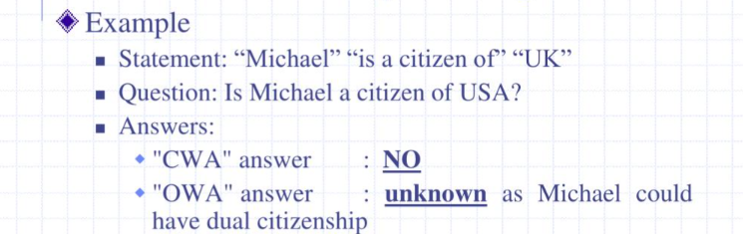
OWL
Open World Assumption (vs Closed World Assumption)
Open World Assumption
  If you cannot prove something: we do not know its status
  Normal assumption when applying logic
Closed World Assumption
  If you cannot prove something: assume it is false
  When it is assumed that the knowledge base is complete, or incomplete but decision must be made regardless
→ OWL was designed for the Semantic Web, where you know you don’t have all information

Slide 27
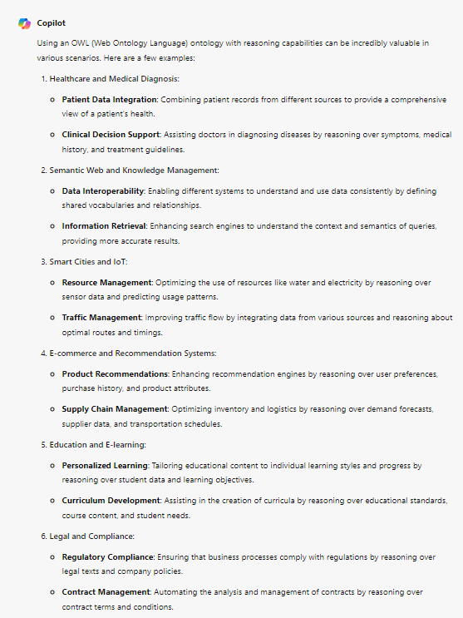
Question: Can you think of a case where OWL reasoning could be of value?
Copilot suggests:
Healthcare and Medical Diagnosis
Semantic Web and Knowledge Management
Smart Cities and IoT
E-commerce and Recommendation Systems
Education and E-learning
Legal and Compliance
...

Slide 28
Pizza Ontology tutorial
In Protege Desktop
https://www.michaeldebellis.com/post/new-protege-pizza-tutorial
We will do Chapter 4 and a bit of Chapter 5 together
You are encouraged to complete the tutorial on your own after the training!

Slide 29
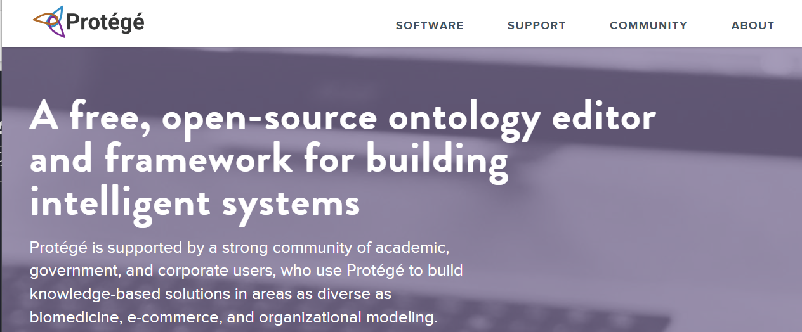
About Protege
Open Source
Developed by Stanford University
Protege desktop allows reasoning
Also web version available, but it does not have reasoning capabilities
Manchester OWL Syntax for class expressions
  https://protegeproject.github.io/protege/class-expression-syntax/

Slide 30
If we have time: let’s make our own ontology (using GenAI)
Let’s ask ChatGPT/CoPilot to help us create an OWL ontology about ...
  A family tree (e.g. Person, Male/Female, hasChild, hasSibling, Uncle)
  An office setting
  ...
Import it into Protege

Slide 31
References / Recommend reading
https://www.michaeldebellis.com/post/new-protege-pizza-tutorial
https://drive.google.com/file/d/1A3Y8T6nIfXQ_UQOpCAr_HFSCwpTqELeP/view

Slide 32
Deep dive: SHACL

Slide 33
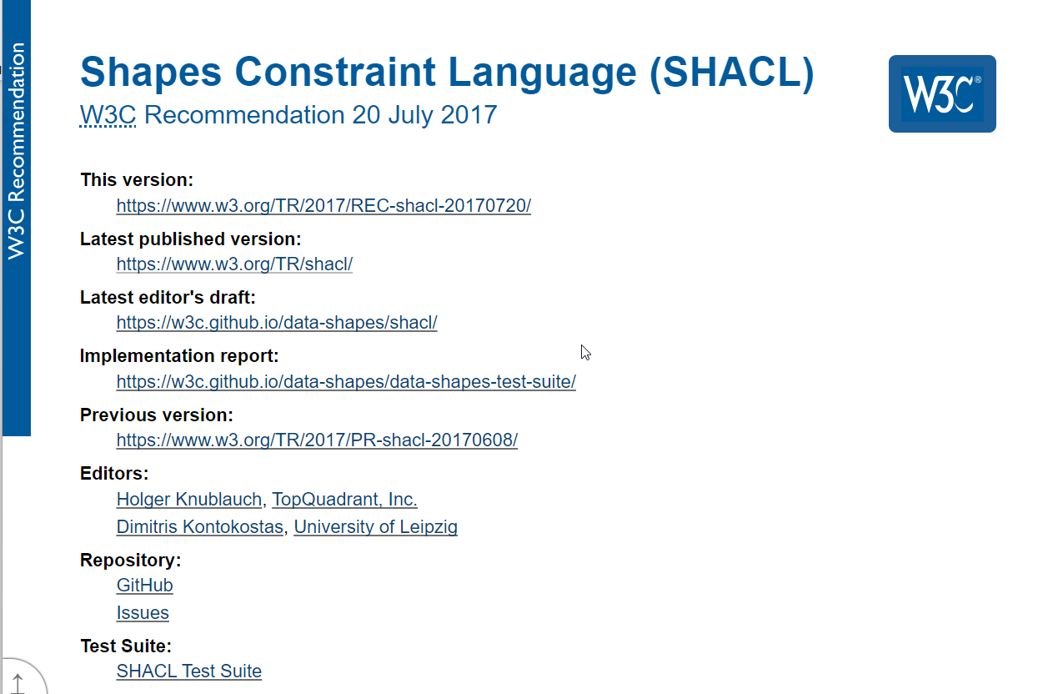
SHACL
Shapes Constraint Language
2017
Designed for RDF data validation
Closed World Assumption

Slide 34
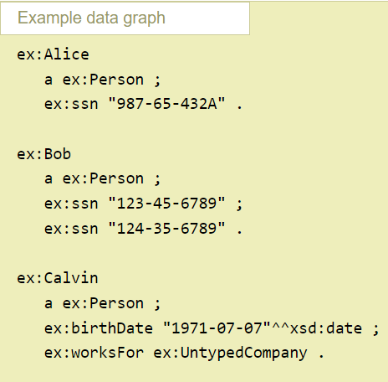
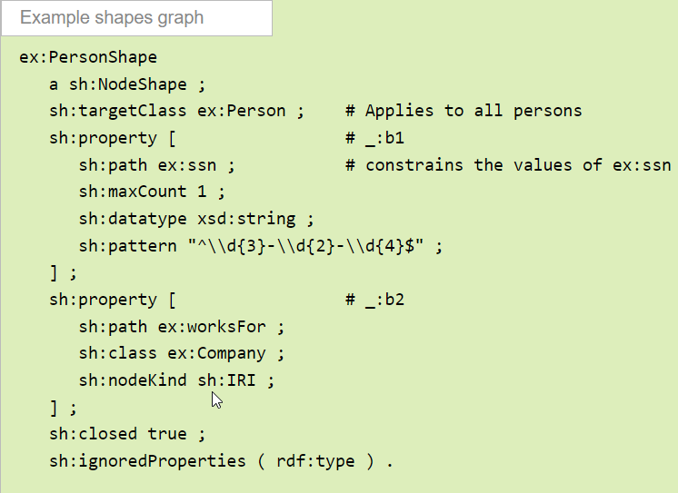
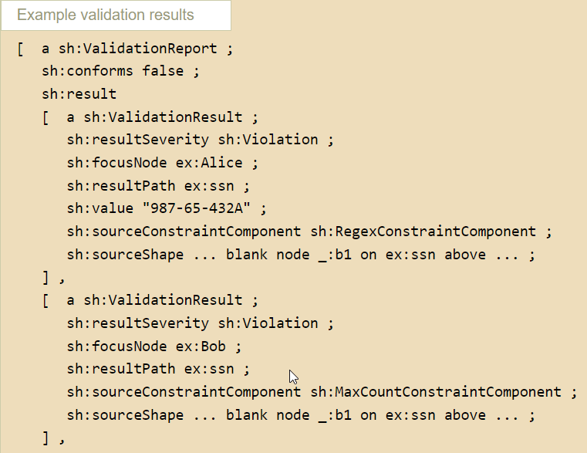
SHACL
Shapes Graph + Data Graph → Validation Report
SHACL gives you primitives to model node shapes and property phapes
SHACL shapes can also be shared as Linked Data
Note that you can also refer to concepts and relationships from other ontologies/vocabularies

Slide 35
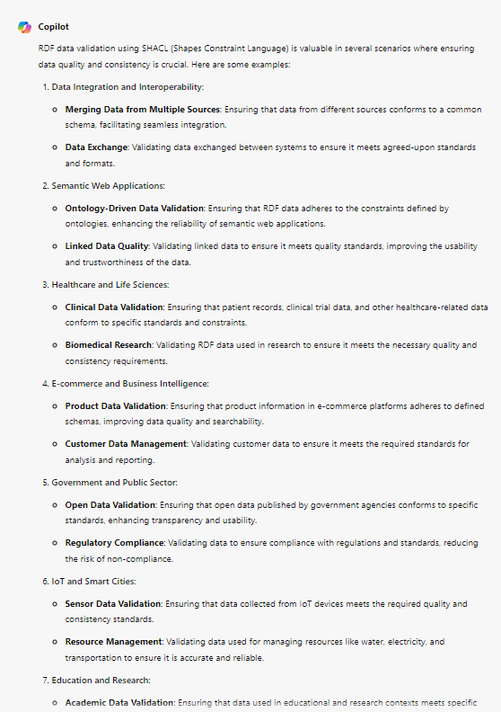
Question: Where would you apply SHACL?
Copilot suggests:
Data Integration and Interoperability
Semantic Web Applications
Healthcare and Life Sciences
E-commerce and Business Intelligence
Government and Public Sector
IoT and Smart Cities
Education and Research

Slide 36
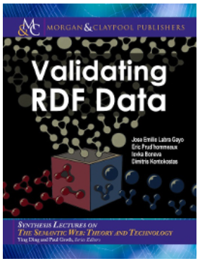
Validating RDF Data
Free HTML version: http://book.validatingrdf.com
We’ll do parts of Chapter 5 together

Slide 37
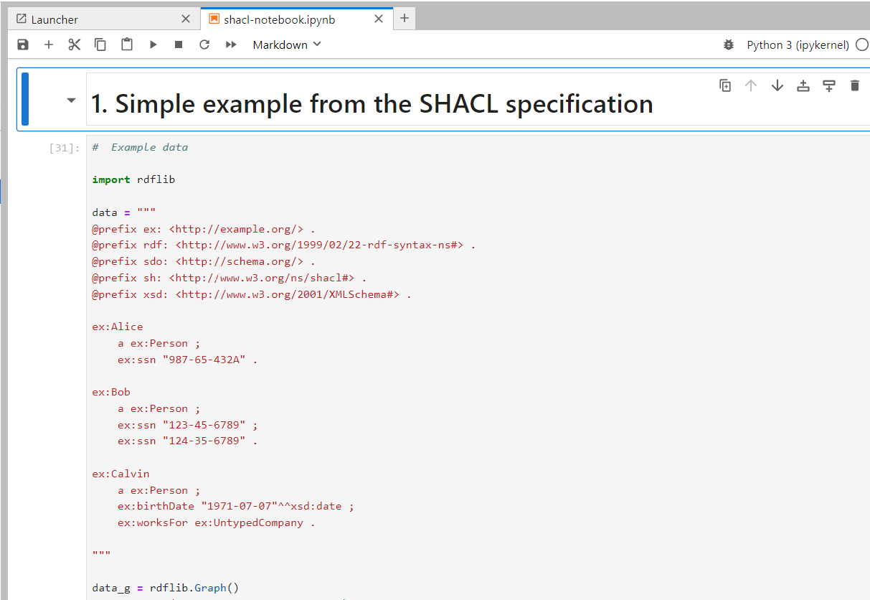
Notebook: shacl-notebook.ipynb
Let’s open `shacl-notebook.ipynb`

Slide 38
References / Recommend reading
https://www.w3.org/TR/shacl/
https://book.validatingrdf.com/
https://medium.com/fluree/what-is-shacl-with-examples-2697f659d465

Slide 39
OWL vs SHACL

Slide 40
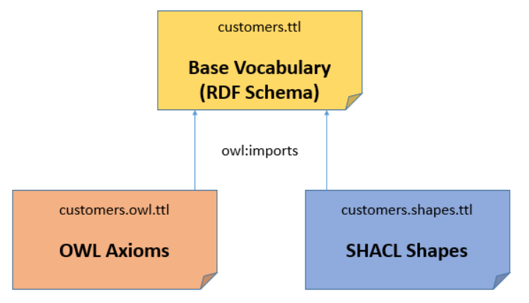
First: OWL and SHACL?
They can be used together
With OWL you can model logical axioma for inferencing
Since OWL does not impose constraints on the data, this can be done with SHACL shapes
You can model these files/graphs separately and only use them when needed

Slide 41
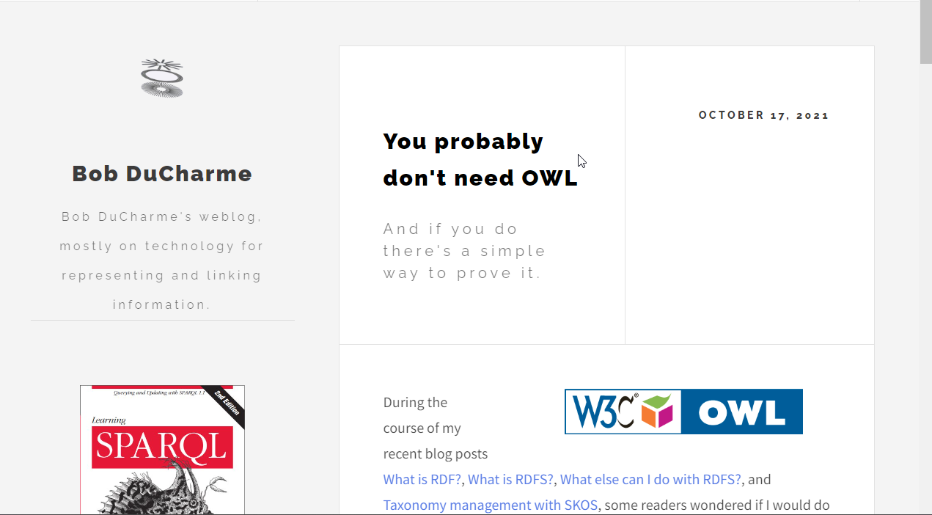
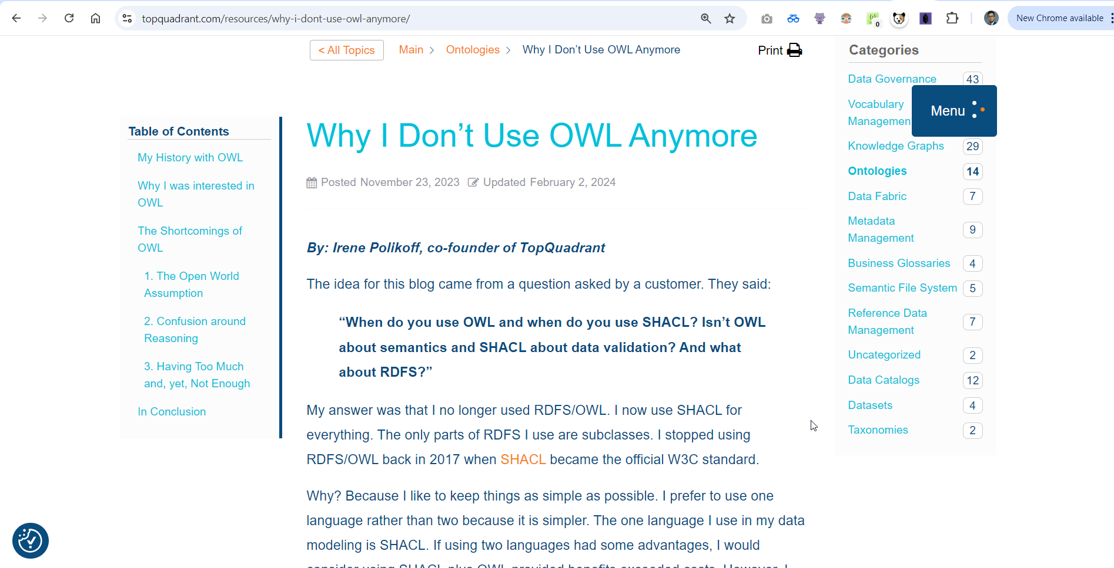
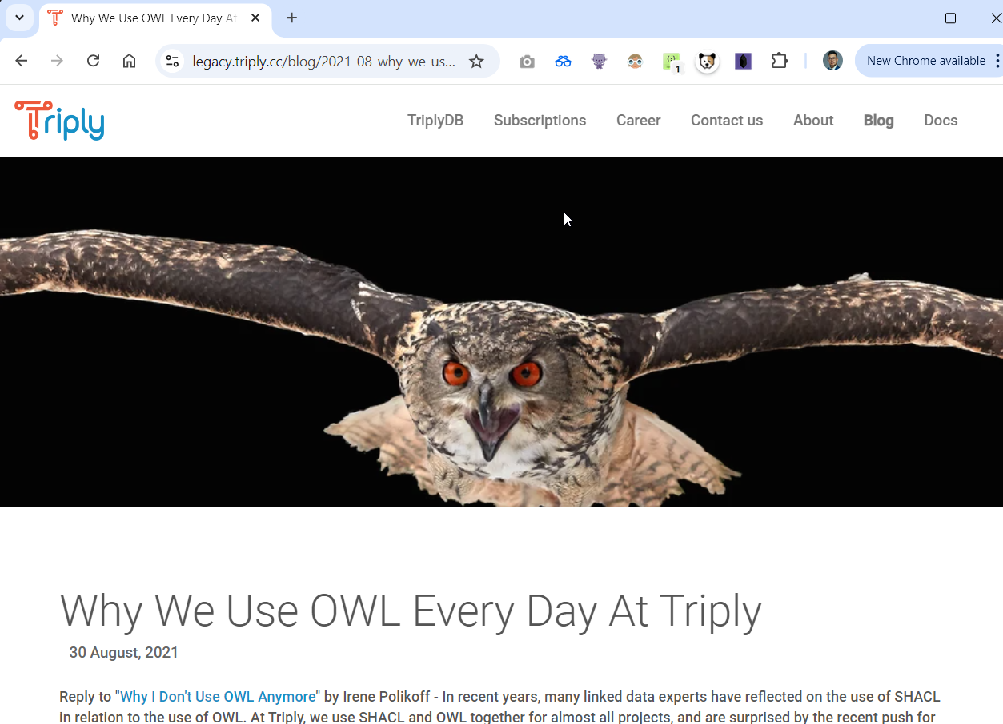
OWL vs SHACL
Is there really a need for using both? It depends.
Team OWL vs Team SHACL
A common argument is that when you don’t need a rich model and never really use logical reasoning/inferencing, then modeling using only SHACL should be fine

Slide 42
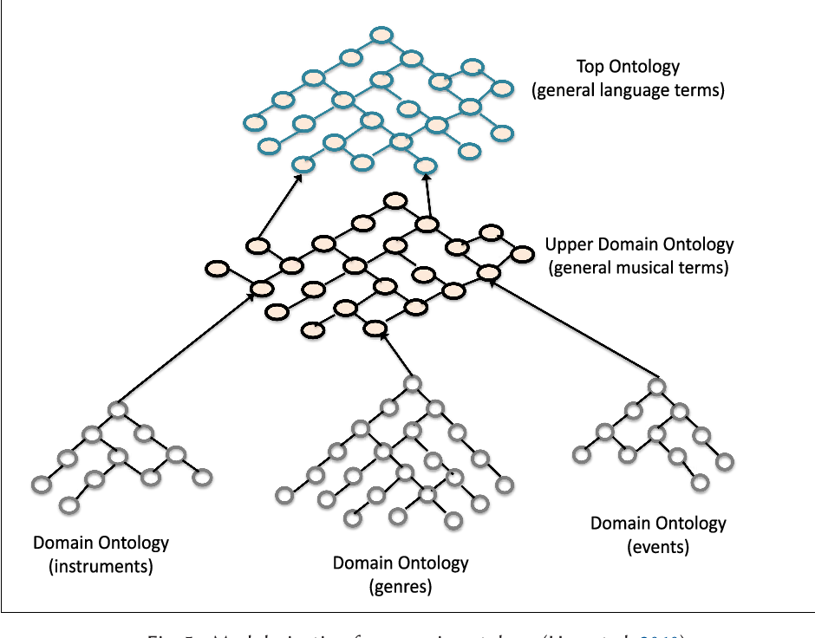
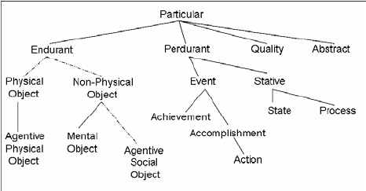
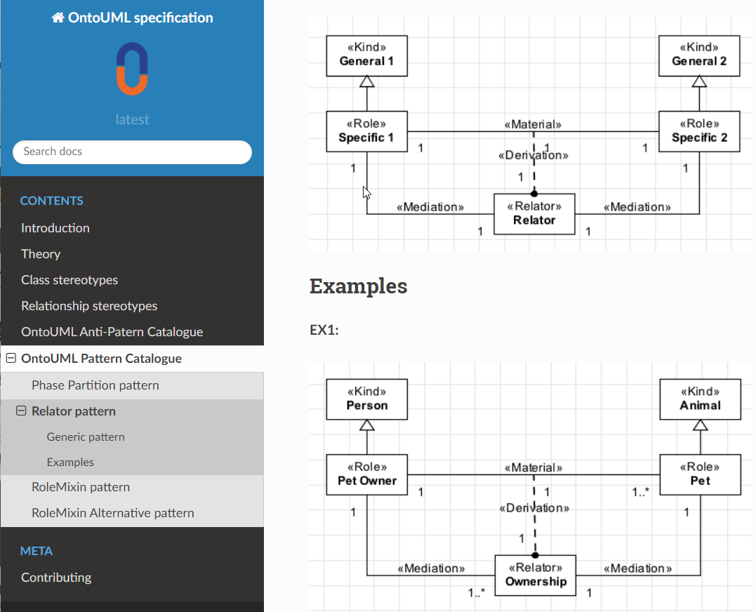
Relevant developments/frameworks: Foundational ontologies such as BFO, DOLCE and OntoUML/UFO
When creating a domain ontology, it may be wise to adopt a foundational (aka upper level) ontology
Dolce
  Descriptive Ontology for Linguistic and Cognitive Engineering
BFO
  Basic Formal Ontology
UFO/OntoUML
  Unified Foundational Ontology
  Often used in software engineering and enterprise modeling

Slide 43
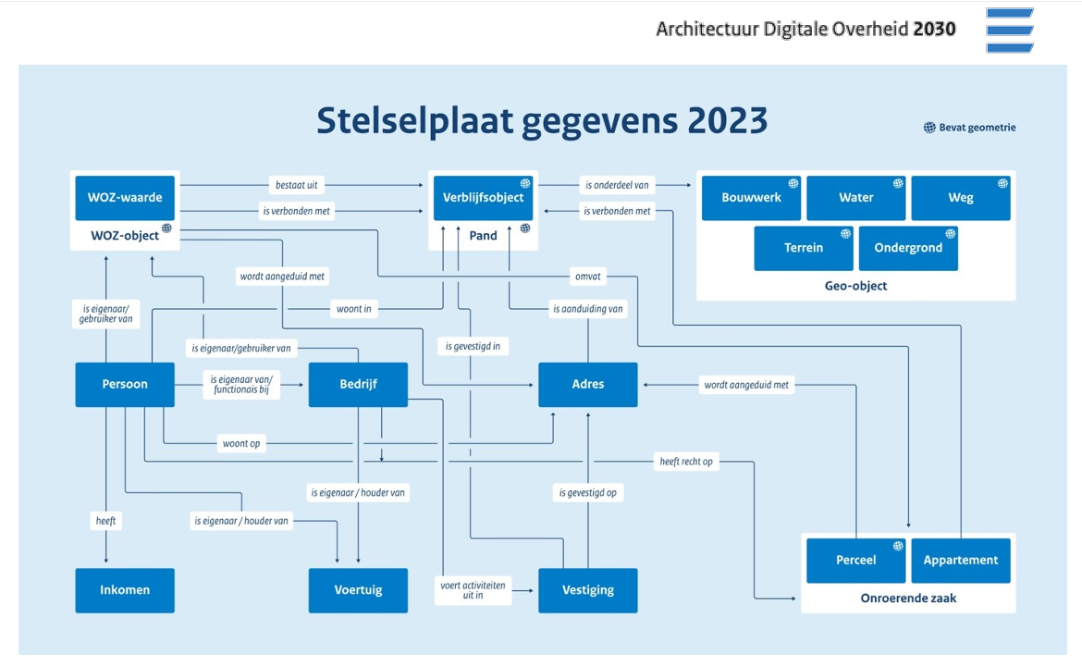
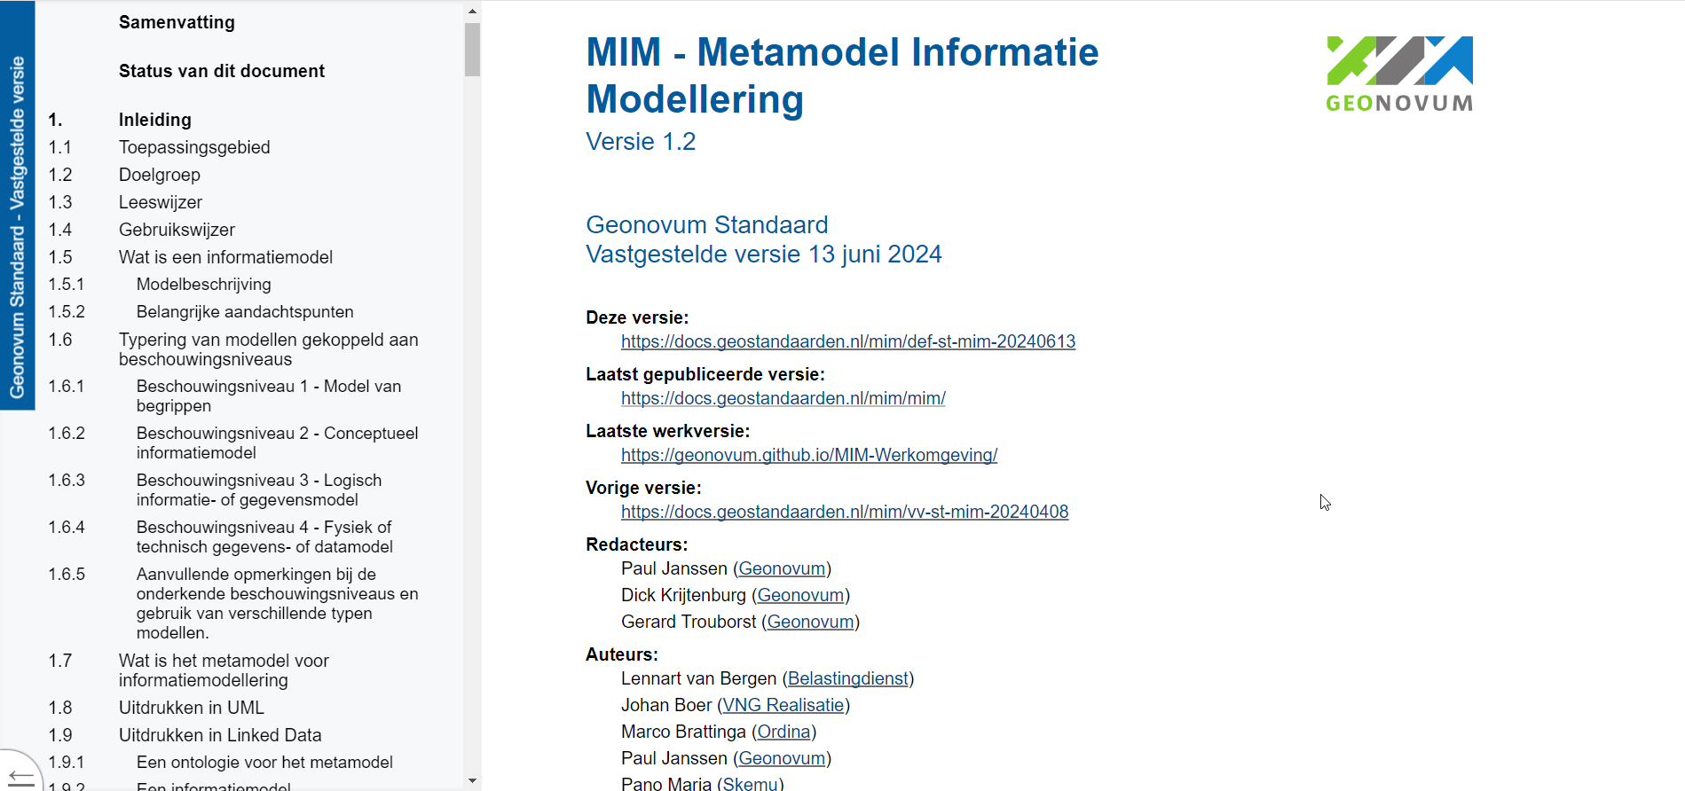
Relevant developments/frameworks: MIM and Reference Architecture 2030
Linked Data increasingly important for the Dutch public domain

Slide 44

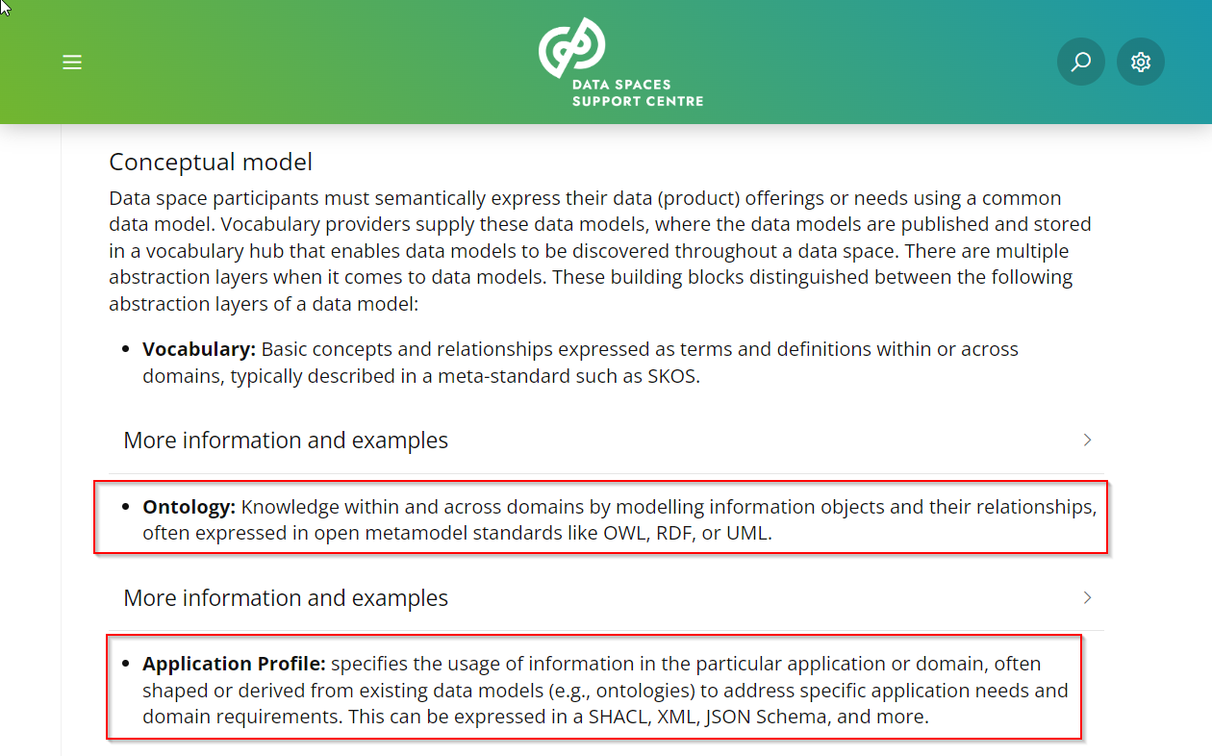
Relevant developments/frameworks: Data Spaces / Collaborative Data Ecosytems
OWL and SHACL mentioned in Data Spaces Blueprint as published by DSSC

Slide 45
References / Recommend reading
https://www.w3.org/TR/owl2-syntax/
https://www.w3.org/TR/shacl/
https://spinrdf.org/shacl-and-owl.html
https://medium.com/the-semantic-data-practitioner/diving-into-the-deep-end-of-rdf-owl-shacl-and-sparql-vs-terminusdb-data-products-9fe26bddab33
https://medium.com/fluree/what-is-shacl-with-examples-2697f659d465
https://www.ontotext.com/knowledgehub/fundamentals/what-is-shacl/
https://www.bobdc.com/blog/dontneedowl/
https://legacy.triply.cc/blog/2021-08-why-we-use-owl/
https://medium.com/@nfigay/do-you-know-what-upper-ontologies-are-and-the-value-it-brings-october-2021-5f43ee5b1553

Slide 46
Closing

Slide 47

Discussion
After today, how do you feel about OWL and SHACL?

Slide 48
Thank you for participating!

Slide 49
About Capgemini
Capgemini is a global business and technology transformation partner, helping organizations to accelerate their dual transition to a digital and sustainable world, while creating tangible impact for enterprises and society. It is a responsible and diverse group of 340,000 team members in more than 50 countries. With its strong over 55-year heritage, Capgemini is trusted by its clients to unlock the value of technology to address the entire breadth of their business needs. It delivers end-to-end services and solutions leveraging strengths from strategy and design to engineering, all fueled by its market leading capabilities in AI, cloud and data, combined with its deep industry expertise and partner ecosystem. The Group reported 2023 global revenues of €22.5 billion.
Get the future you want | www.capgemini.com

